Slide 1
IBM University Engagement Project Submission
“Exploring the Power of Agentic AI with IBM Granite and LangFlow”

Slide 2

Project Tile – Interview Trainer Agent – AI-Powered Mock Interview Preparation Platform
Domain of Project – Education Technology (EdTech) / Career Development
Student Name | Recent Passport Photo | Email ID | Mobile number [WhatsApp]
SAI SUMANTH G |  | sumanthg.sai@gmail.com | 9025208253

Slide 3
Problem Statement
Problem Statement – Interview Trainer Agent
The Challenge
Many students and job seekers face difficulties during interviews because they lack proper practice, personalized guidance, and real-time feedback on their performance. Traditional preparation methods often provide generic questions that do not align with a candidate's resume, skills, or target job role. As a result, candidates struggle to identify their weaknesses, improve their answers, and build confidence before attending actual interviews. There is a need for an intelligent system that can simulate real interview experiences and provide personalized evaluation and improvement suggestions.
The Objective
Build an AI-Powered Interview Trainer Agent that helps candidates prepare for interviews through personalized and interactive mock interview sessions.
The solution should:
Analyze uploaded resumes and identify relevant skills.
Generate role-specific interview questions using IBM Granite Models.
Conduct AI-powered mock interviews.
Evaluate candidate answers based on relevance, technical accuracy, clarity, and completeness.
Provide scores, feedback, and improvement suggestions.
Help users build confidence and improve interview performance.

Slide 4
Technology Used
I used LangFlow + IBM watsonx.ai + IBM Granite Models
LangFlow
Visual platform for designing and managing AI workflows.
Connects multiple AI components and agents seamlessly.
Enables rapid development of Agentic AI applications.
IBM watsonx.ai
Provides access to IBM Foundation Models.
Supports prompt engineering and model deployment.
Ensures scalability, security, and AI governance.
IBM Granite Models
Generates interview questions based on resumes and job roles.
Evaluates candidate answers intelligently.
Provides personalized feedback and scoring.
Streamlit
Builds an interactive and user-friendly web interface.
Allows users to upload resumes and answer interview questions.
Displays evaluation results and feedback in real time.

Slide 5
Proposed Solution - AI-Powered Interview Trainer Agent
The proposed solution is a multi-agent AI-powered Interview Trainer Agent built using LangFlow, IBM watsonx.ai, IBM Granite Models, and Streamlit to help students and job seekers improve their interview performance through personalized mock interview sessions. The system addresses common challenges in interview preparation, such as lack of practice, limited feedback, and role-specific question generation, through an intelligent and modular architecture.
At its core, the solution analyzes the user's uploaded resume to extract key skills, technologies, projects, and areas of expertise. Based on this information and the selected job role (such as Java Developer, Python Developer, or Web Developer), IBM Granite models generate personalized interview questions that closely match real-world interview scenarios. The system then evaluates user responses and provides detailed feedback, scores, and improvement suggestions.
The system consists of four key agents:
Resume Analysis Agent extracts and summarizes important skills, projects, certifications, and technical competencies from the uploaded resume.
Question Generation Agent generates personalized technical and HR interview questions based on the resume content and selected job role.
Answer Evaluation Agent analyzes candidate responses for relevance, technical correctness, clarity, communication quality, and completeness, then assigns scores and feedback.
Performance Feedback Agent identifies strengths and weaknesses, provides improvement suggestions, and recommends focus areas for future interview preparation.
The solution includes a user-friendly interface built using Streamlit, where users can upload resumes, select their target role, answer interview questions, and view evaluation results instantly.
LangFlow is used to orchestrate the agent workflow and manage interactions between different components, while IBM watsonx.ai provides model access, deployment capabilities, and AI governance. IBM Granite models power question generation, answer evaluation, reasoning, and personalized feedback.
Overall, this solution delivers an end-to-end intelligent interview preparation platform that helps users build confidence, improve communication skills, identify knowledge gaps, and enhance their chances of success in technical and HR interviews.

Slide 6
Langflow component Used
1) Chat Input
Acts as the user interaction interface where candidates upload their resume, select their target job role, and provide answers to interview questions.
2) IBM watsonx AI Agent
Processes user inputs and coordinates the interview workflow using IBM Granite Models. It handles resume analysis, question generation, answer evaluation, and feedback generation.
3) IBM Granite Model
Granite-4.0-8B-Instruct
Used for:
Resume understanding
Interview question generation
Answer evaluation
Personalized feedback and scoring
4) Prompt Component
Provides structured prompts to guide the Granite model in generating role-specific interview questions and evaluating candidate responses accurately.
5) File Component
Accepts and processes uploaded resumes (PDF/Text format) and extracts relevant information such as skills, projects, certifications, and technologies.
6) Chat Output
Displays generated interview questions, candidate scores, feedback, strengths, weaknesses, and improvement suggestions.
7) Parser Component
Formats model outputs into structured responses, making evaluation results easy to read and understand.

Slide 7
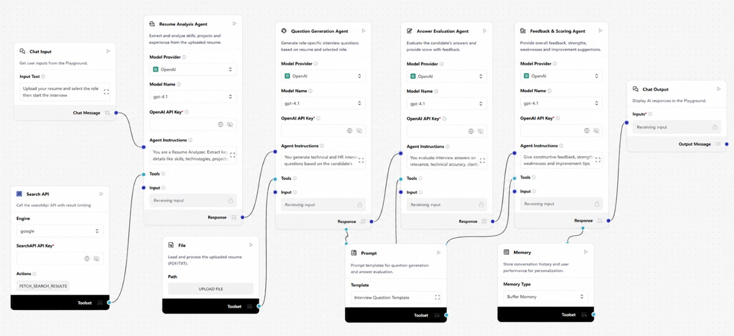
Langflow workflow -

Slide 8
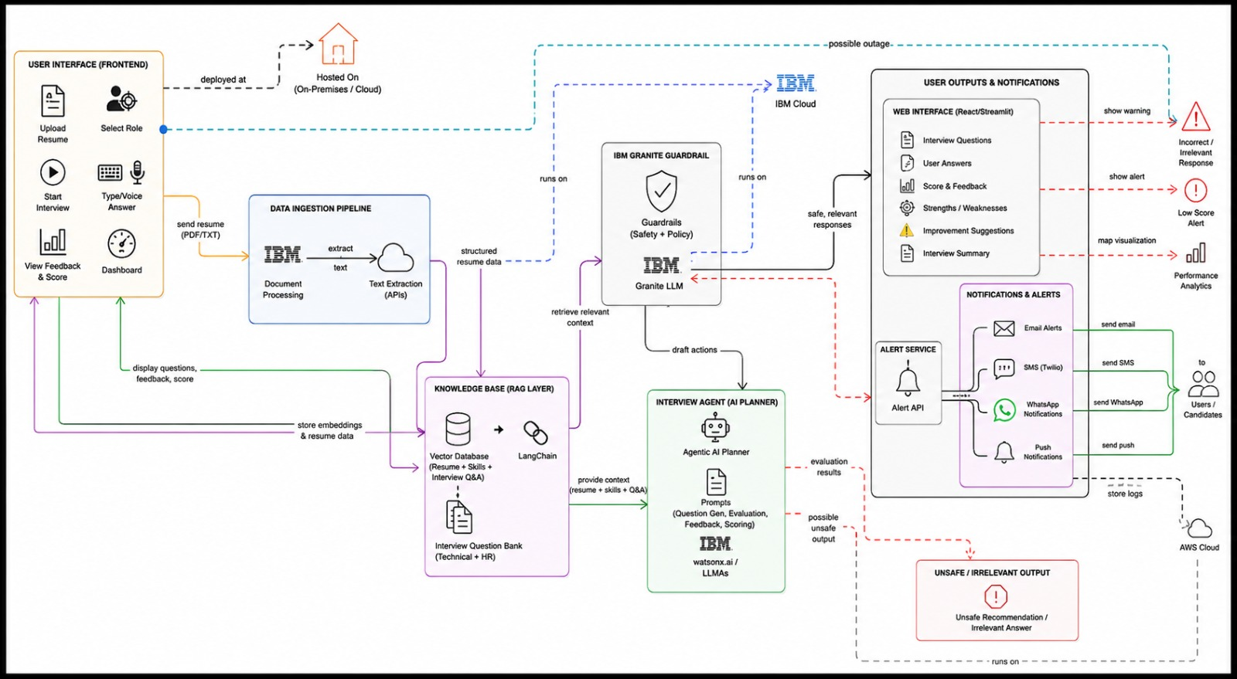
Architecture blueprint

Slide 9
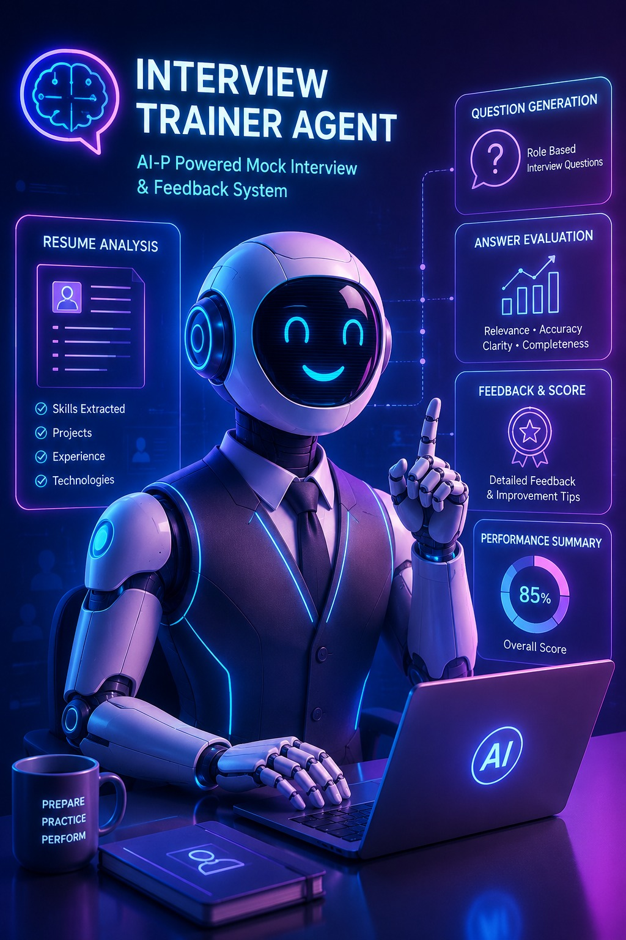
Role of Agentic AI in the solution
Role of Agentic AI in Interview Trainer Agent
Agentic AI enables the Interview Trainer Agent to function as an intelligent and autonomous interview preparation system rather than a traditional question-answer application. Using IBM watsonx.ai and IBM Granite Models, the system coordinates multiple specialized agents that work together to deliver a personalized mock interview experience.
Each agent performs a specific task, such as analyzing resumes, generating interview questions, evaluating candidate responses, and providing detailed feedback. These agents collaborate seamlessly to ensure accurate assessments and meaningful recommendations.
Agentic AI provides context awareness by understanding the candidate's resume, skills, projects, and selected job role. Based on this context, it generates relevant technical and HR interview questions and adapts the interview flow according to user performance.
The system also supports continuous learning and improvement by identifying strengths, weaknesses, and skill gaps, enabling candidates to focus on areas that require improvement.
Overall, Agentic AI transforms the platform into a smart virtual interviewer that offers personalized guidance, real-time evaluation, and actionable feedback, helping users improve their confidence and interview readiness.

Slide 10
Technology Used
LangFlow
Used to design and orchestrate the multi-agent workflow for resume analysis, question generation, answer evaluation, and feedback.
IBM Granite Model
Granite-4.0-8B-Instruct is used for resume understanding, interview question generation, answer evaluation, and personalized feedback.
IBM watsonx.ai
Provides access to Granite models, prompt management, AI deployment, and governance capabilities.
Streamlit
Used to build an interactive web interface for resume upload, mock interviews, scoring, and feedback visualization.
PDF Processing
Extracts text and relevant information from uploaded resumes for skill and experience analysis.
Agentic AI
Coordinates multiple AI agents that collaborate to conduct interviews, evaluate answers, and provide improvement suggestions.

Slide 11
Novelty and Uniqueness
The proposed Interview Trainer Agent stands out by combining Agentic AI, Resume Analysis, and Personalized Interview Evaluation into a single intelligent platform.
Multi-Agent Intelligence
Multiple AI agents work together to analyze resumes, generate questions, evaluate answers, and provide feedback.
Resume-Based Personalization
Interview questions are tailored according to the candidate's skills, projects, and selected job role.
Real-Time Evaluation
Provides instant scores, strengths, weaknesses, and improvement suggestions after each response.
Adaptive Interview Experience
Adjusts questions and feedback based on user performance.
Scalable & Reliable
Built using IBM watsonx.ai, IBM Granite Models, LangFlow, and Streamlit for a secure and scalable solution.

Slide 12
Git Hub Link
Github URL – https://github.com/SaisumanthG/Interview-Trainer-Agent---IBM
·
·
·

Slide 13
Future Scope
1. Voice-Based Interview Assistant
The system can be enhanced with voice interaction to conduct realistic mock interviews. Users can answer questions through speech instead of typing. This will improve communication, confidence, and speaking skills.
2. AI-Powered Career Guidance
The platform can recommend suitable career paths based on interview performance. It can also suggest certifications, courses, and learning resources. This helps users continuously improve their skills and job readiness.
·
·
·

Slide 14


